Slide 1
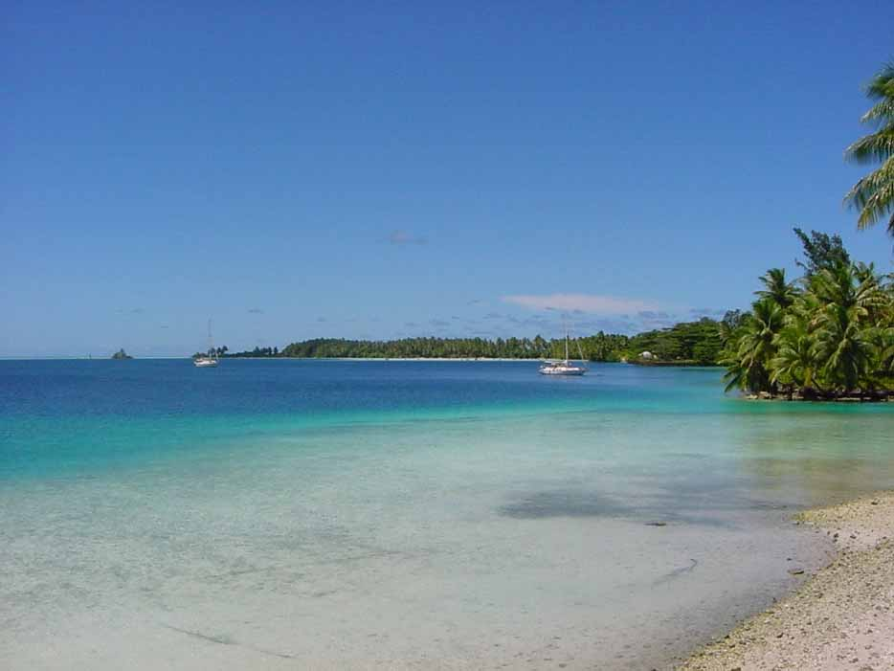
Movement patterns of apex predators at a ‘pristine’ coral atoll
Jenn Caselle
University of CA Santa Barbara
Yannis Papastamatiou, Alan Friedlander, Chris Lowe and Kevin Weng
Funded by The Marisla Foundation, The Nature Conservancy and IGFA with support from the US Fish and Wildlife Service and The Nature Conservancy

Slide 2
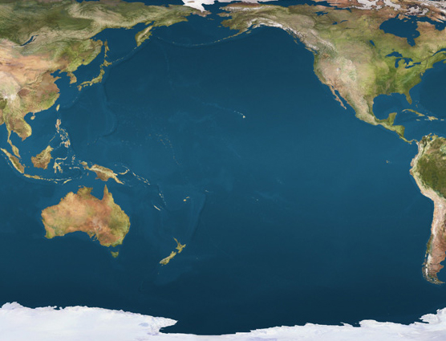
Santa Barbara, CA
Palmyra Atoll
You are here
Located 1600 km south of Hawaii – Northern Line Islands
within the Inter-tropical Convergence Zone
450 – 500 cm of rainfall per year!
Notes:
Don’t usually start a talk describing loc but

Slide 3
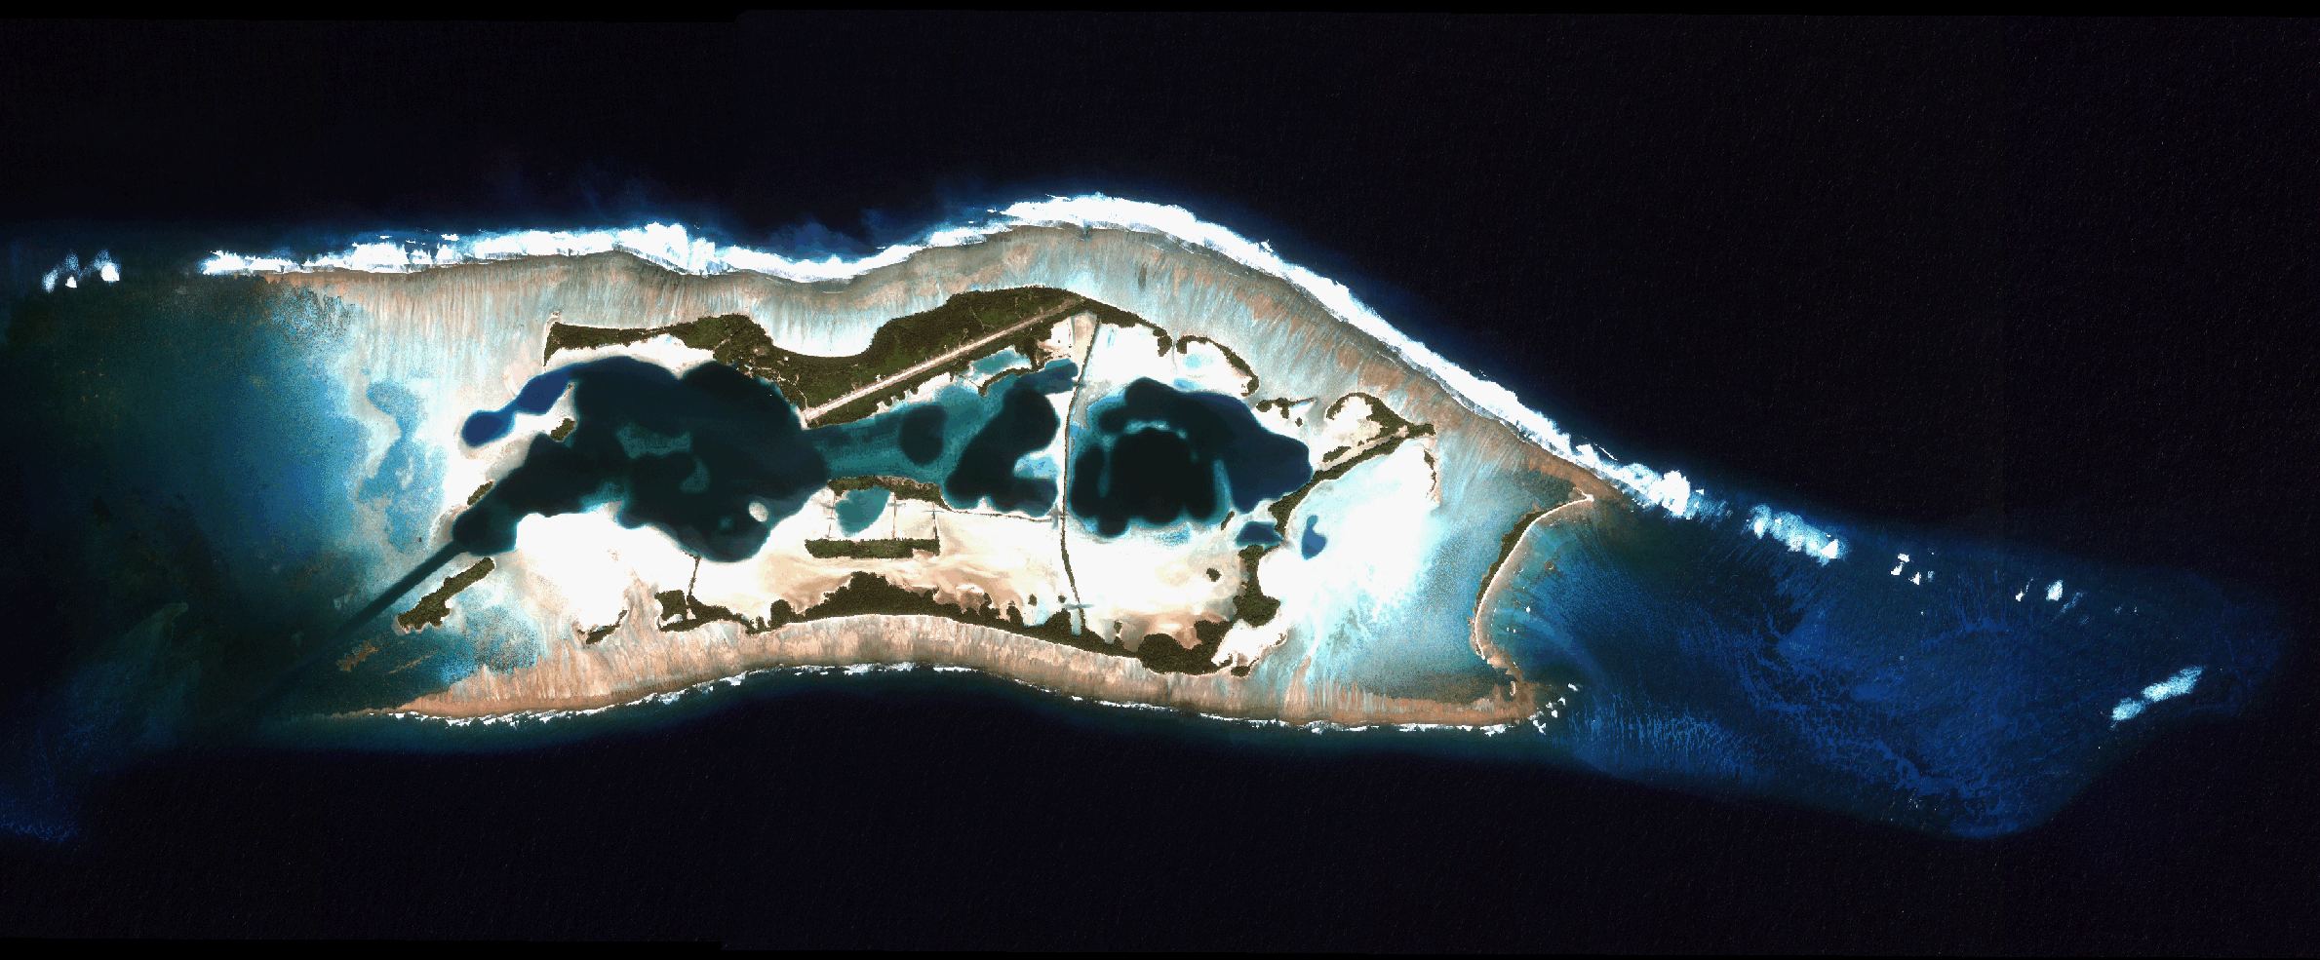
Palmyra Atoll
2 km
12 km² atoll
6,277 hectares of submerged reef and reef flat
Dredged to reclaim land for airstrips and causeways in WWII
Largely uninhabited since 1944

Slide 4
One of few remaining “intact” marine ecosystems
Human impacts low
High biomass apex predators (up to 60% fish biomass)
From DeMartini et al. 2008, Sandin et al. unpub. data

Slide 5
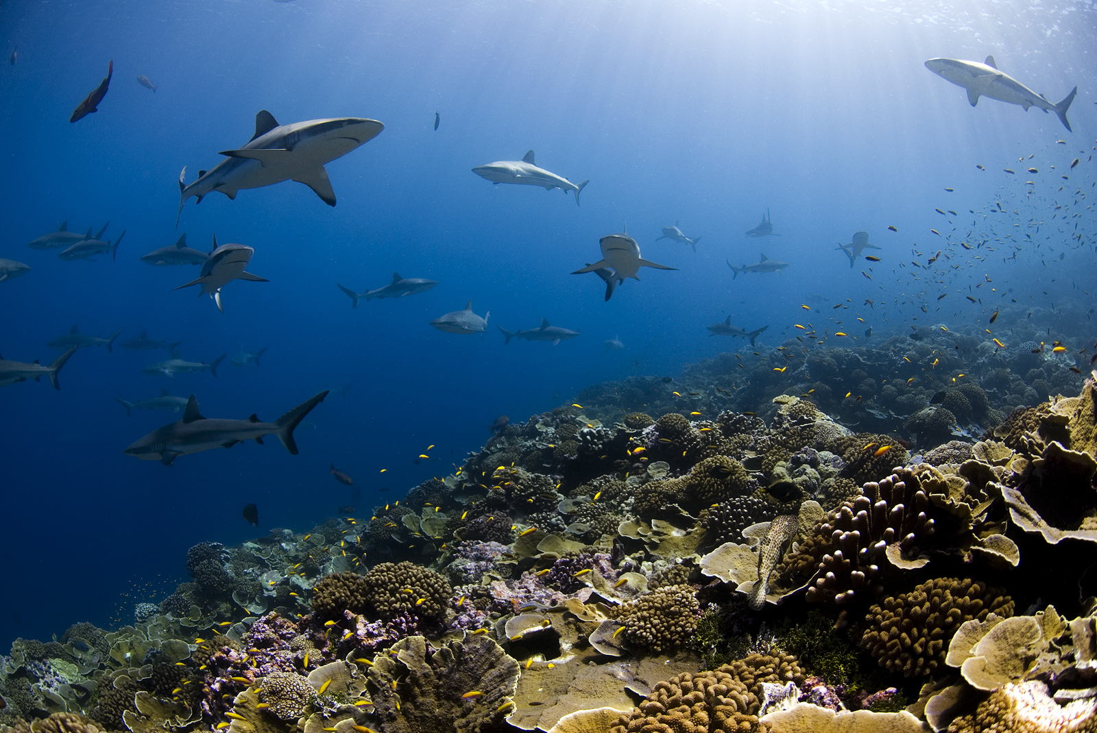
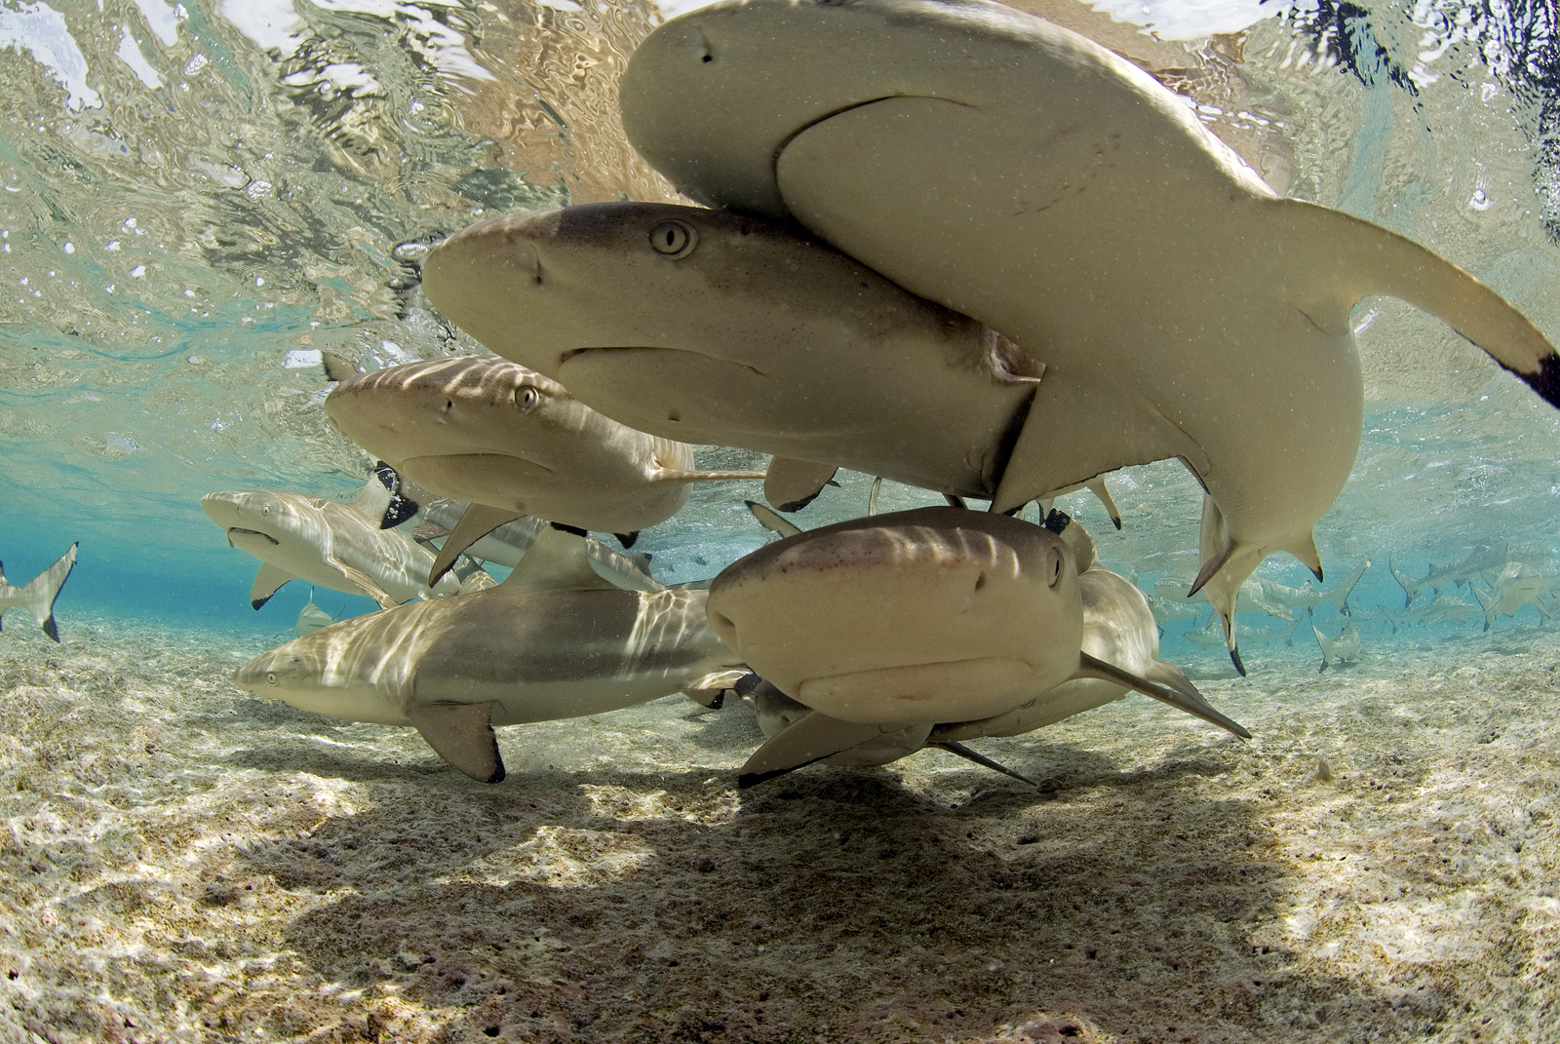
Predator-prey Interactions in an Apex Predator Dominated Community
Sala
San Felix
Determine the spatial and temporal patterns of movement and habitat utilization by predators and prey to elucidate species interactions and ecosystem dynamics.
Notes:
So, we’ve shifted the focus of the study to better understanding the behavior of predators in hopes of coming back to the bonefish.

Slide 6
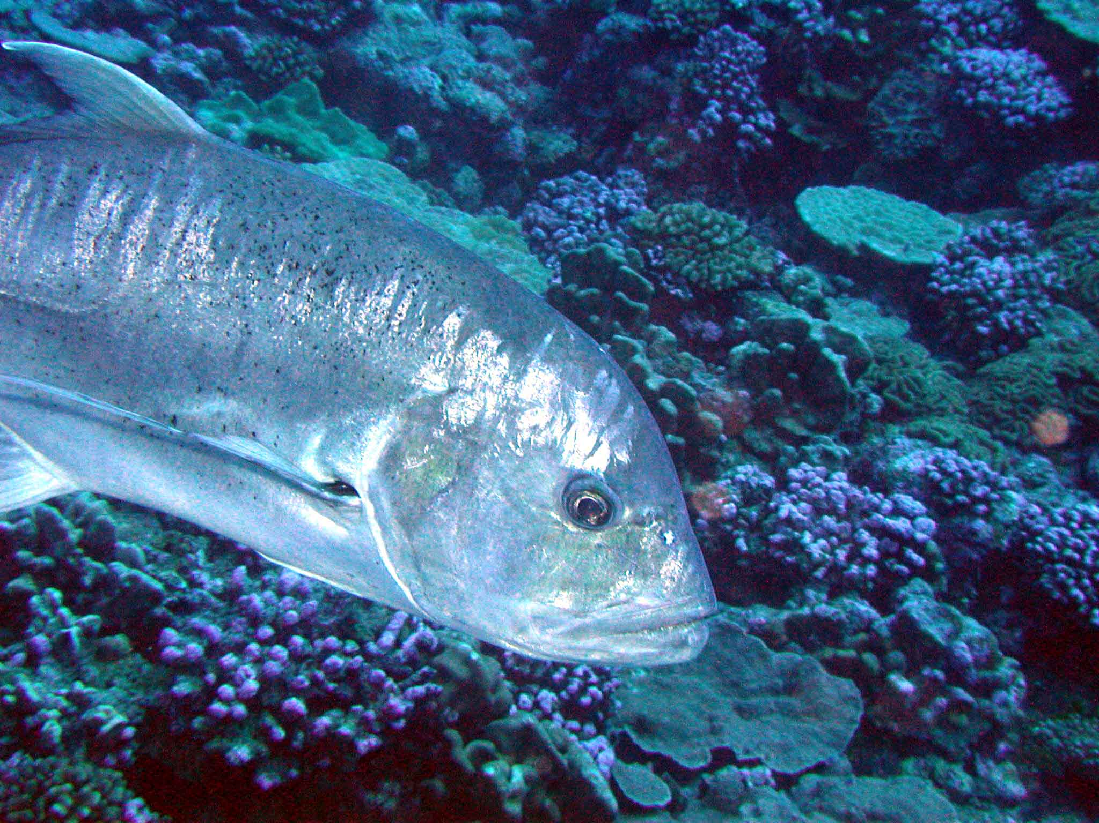
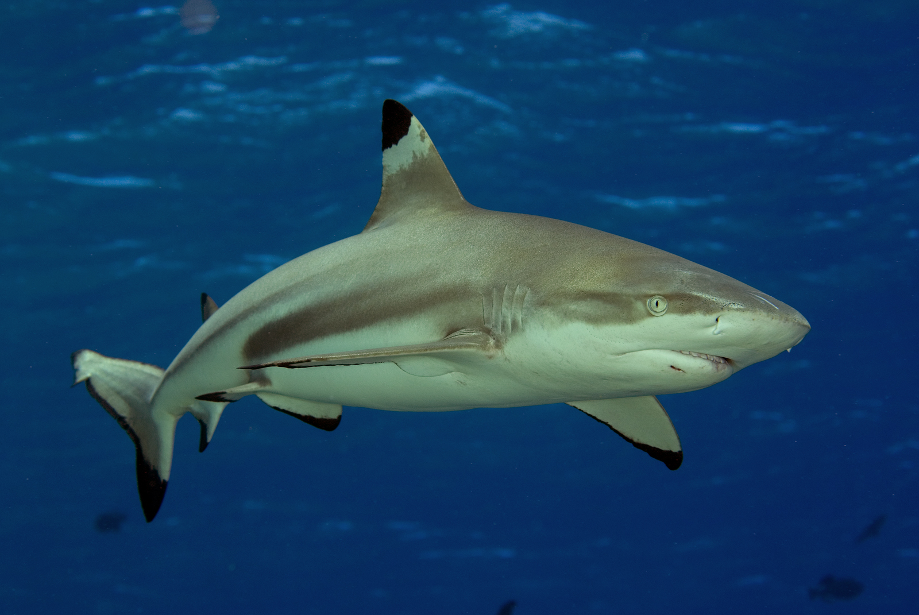
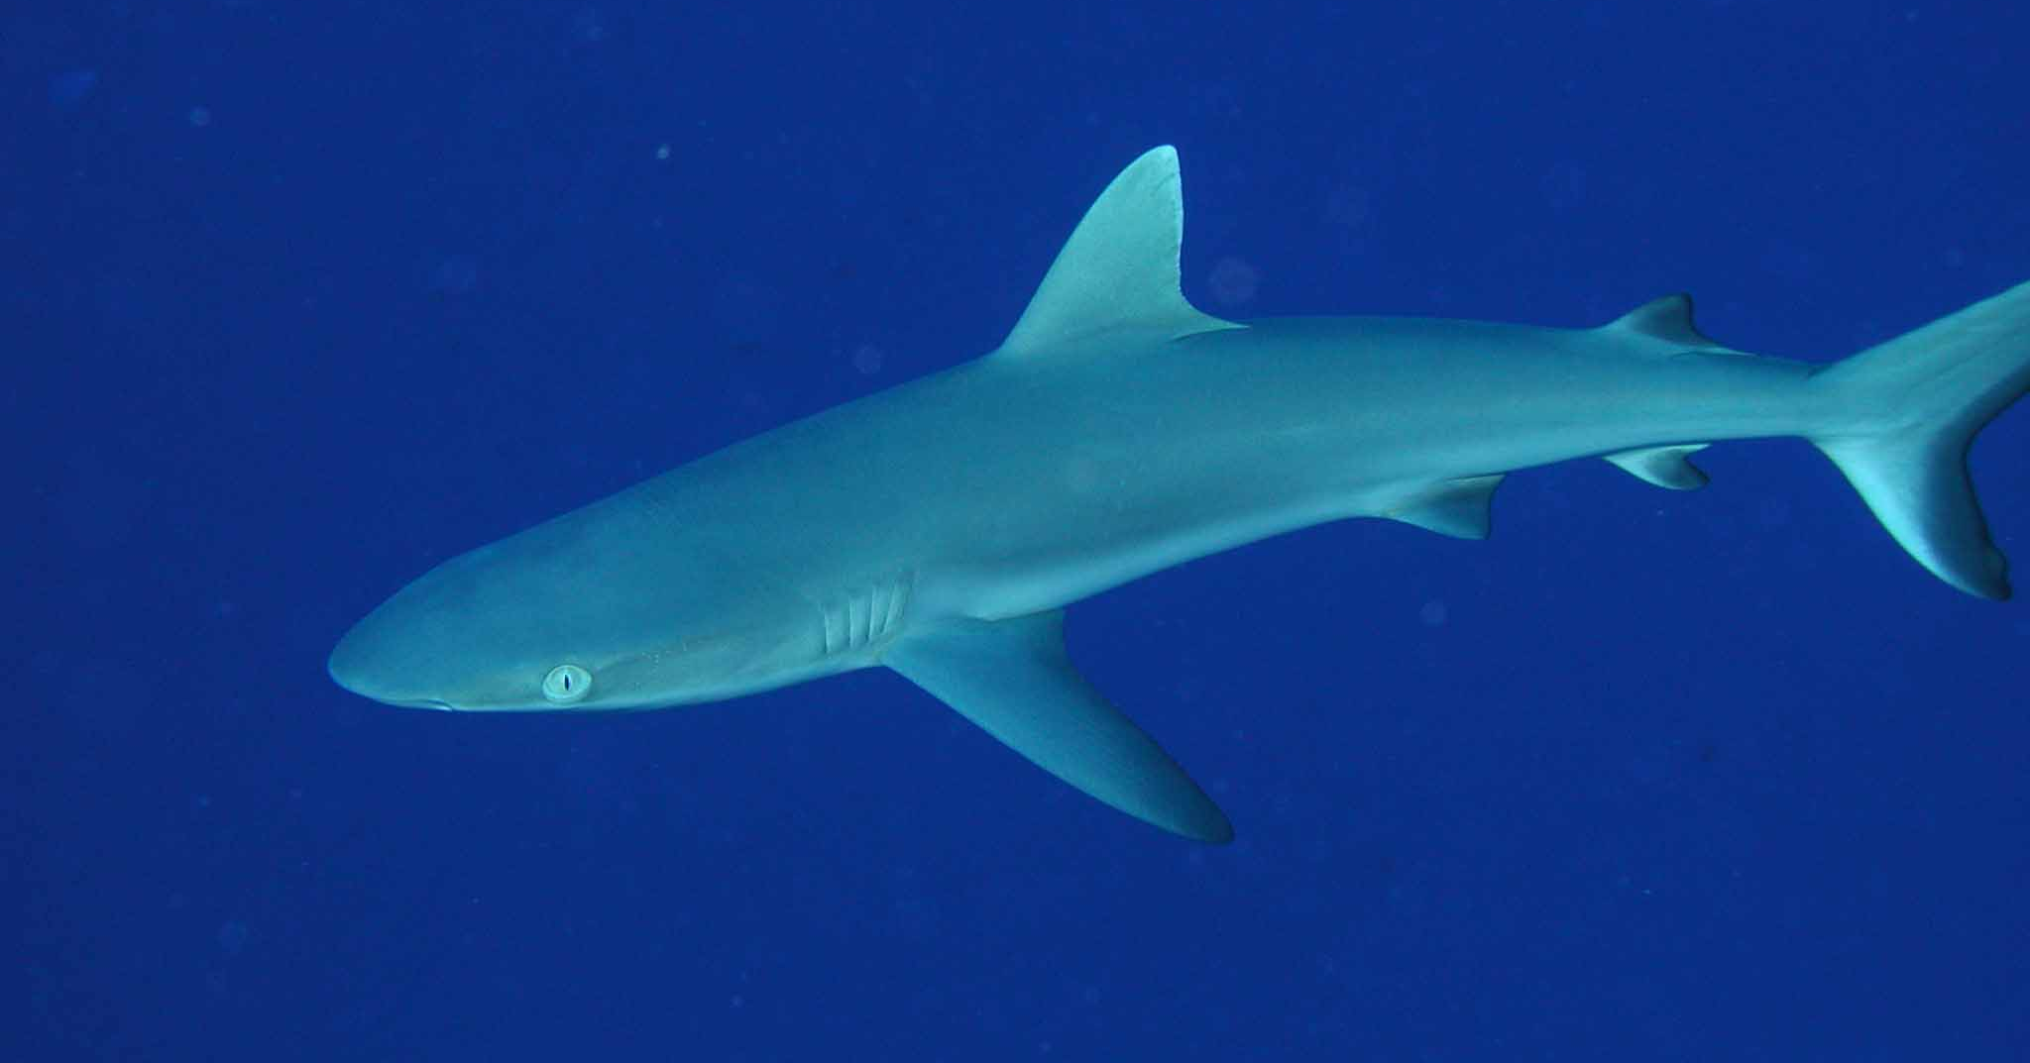
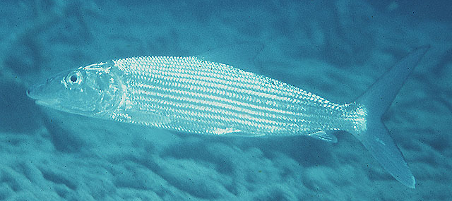
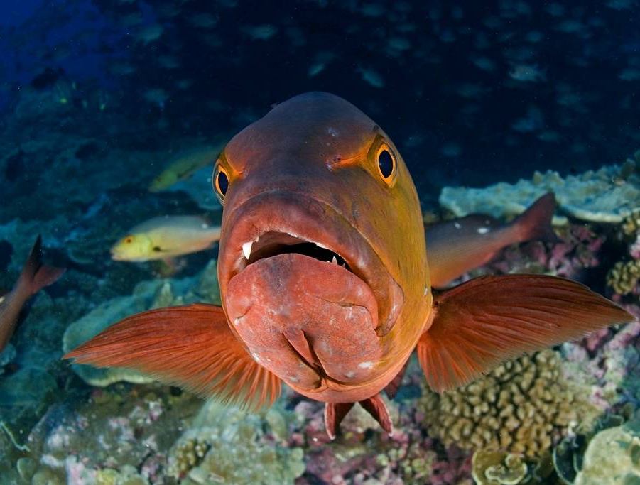
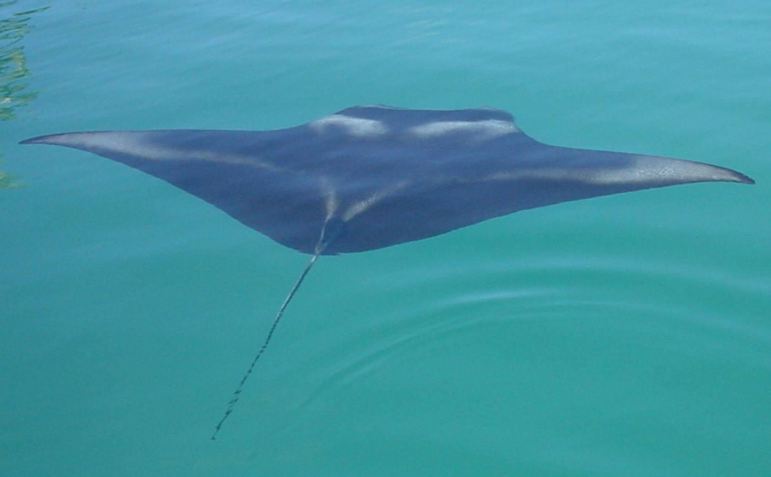
N=59
N=55
Targets of movement studies at Palmyra
N=29
N=25
N=26
N=23

Slide 7
Blacktip reef shark - Carcharhinus melanopterus
Photo Enric Sala
Notes:
Common around reef flats, atoll lagoons, and reef edges in central and south Pacific (Hobson 1963)
Form loose aggregations for mating (Porcher 2005)
Feed on reef edge and flat associated fishes and crustaceans (Stevens 1984, Hobson 1963)
Thought to have small home ranges (~ 1 km) (Stevens 1984, Nelson & Johnson 1980)

Slide 8
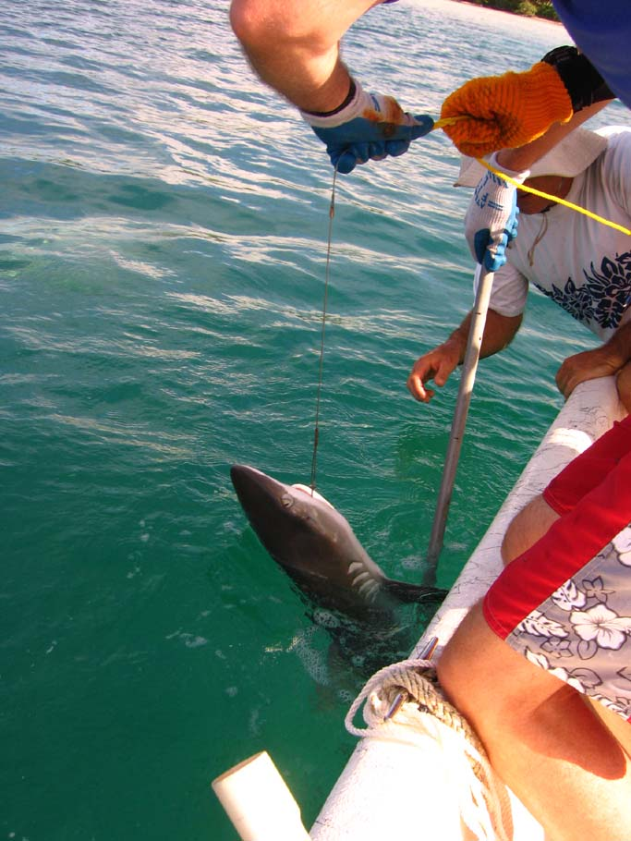
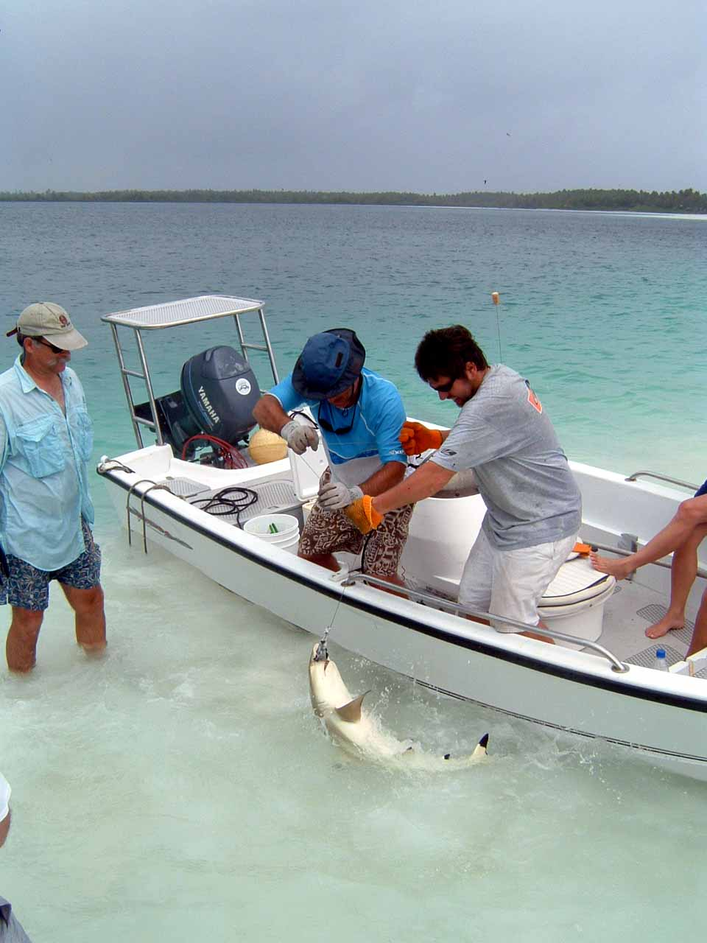
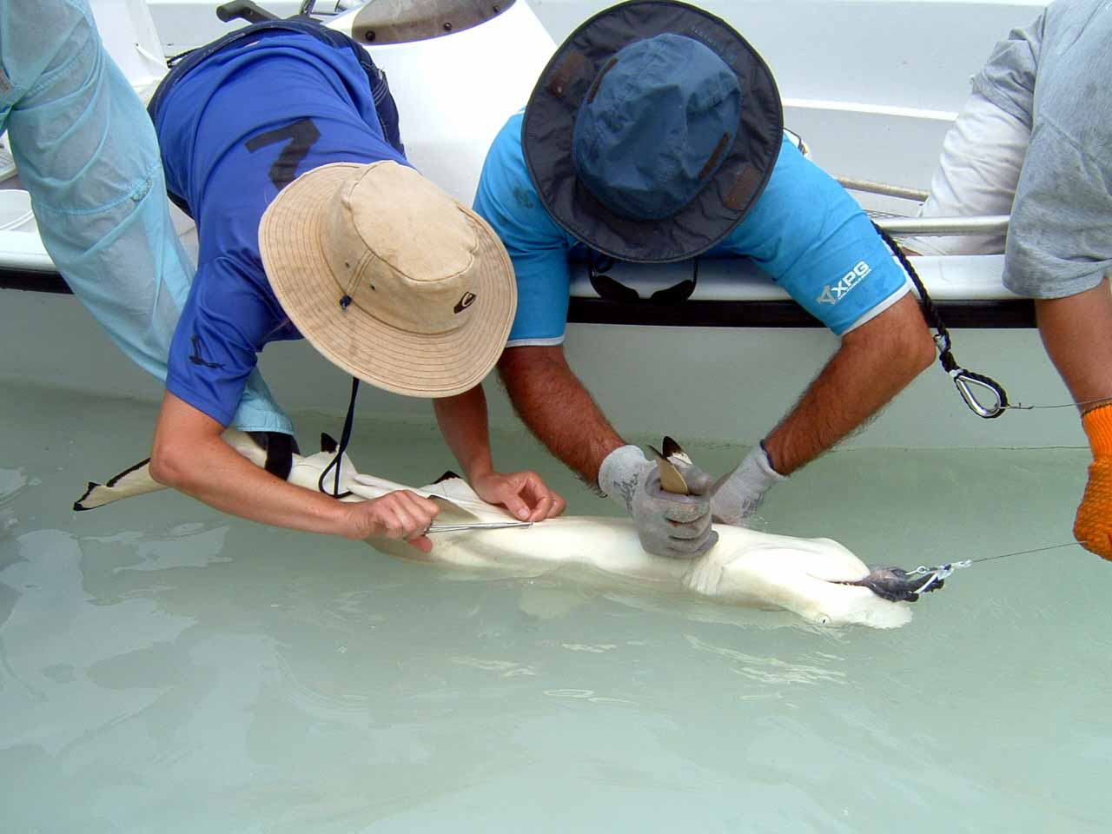
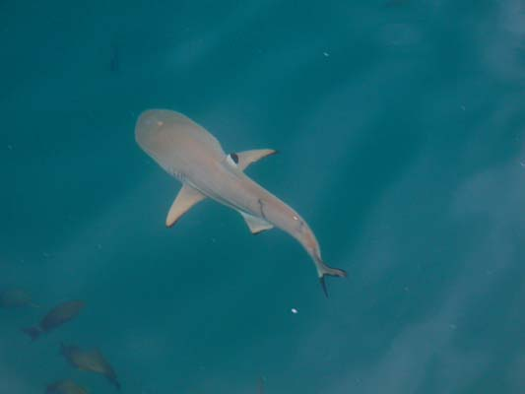
Predator Tagging
Blacktip sharks
Acoustic monitoring:
59 total
30 females, 29 males
77-132 cm TL
Active tracking:
13 sharks
Ranging from 4-72 hours
West lagoon only

Slide 9
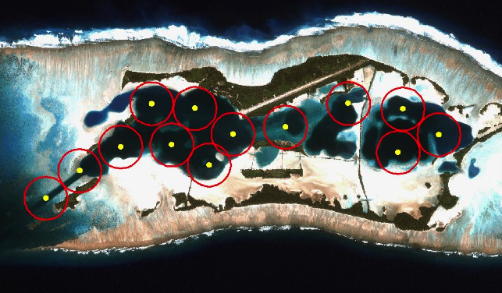
Acoustic array in the beginning…
1 km
Vemvo VR2w acoustic recievers with approximate detection range
Notes:
Stared work on lagoon animals

Slide 10
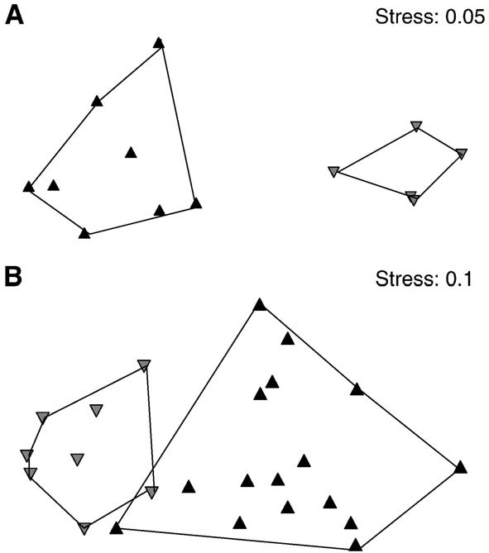
Strong site fidelity to lagoons
‘04-05
Tagged in West Lagoon
Tagged in East Lagoon
’06-07
Papastamatiou et al. 2010
Notes:
Fig. 2. Non-metric multidimensional scaling ordination of space utilization between
sharks tagged in the western (black triangles) and the eastern (grey triangles) lagoons
during A) 2004/2005, and B) 2006/2007.

Slide 11
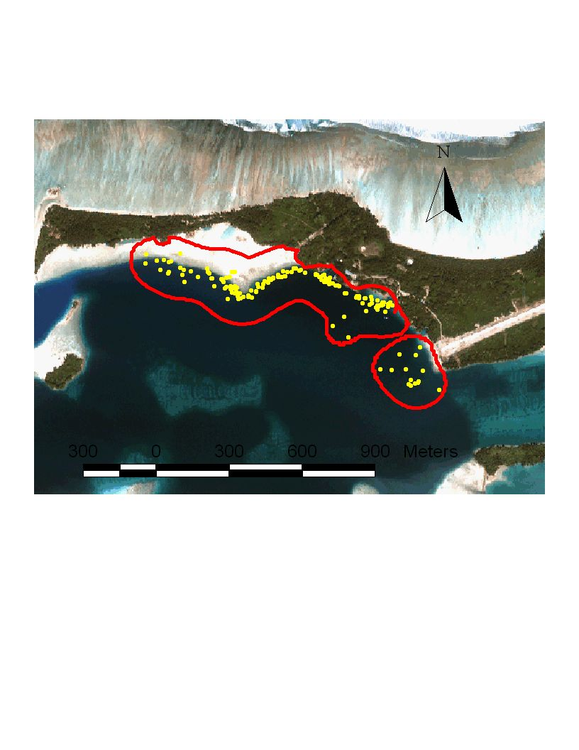
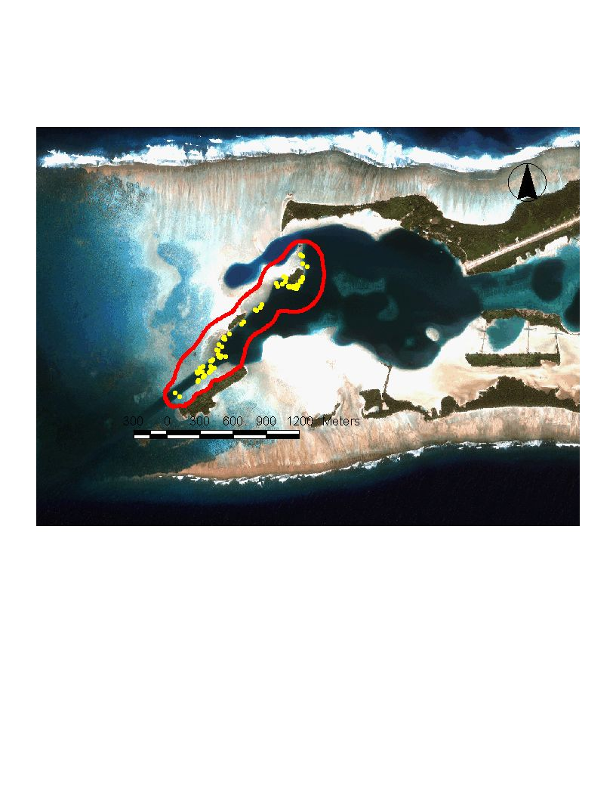
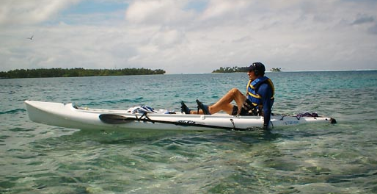
Short-term Movement of Blacktip Sharks : Active Tracking
Sm. home range
(0.48 ± 0.24 km² , N = 13)
High site fidelity
Movements oriented to ledges
72 h track
48 h track

Slide 12
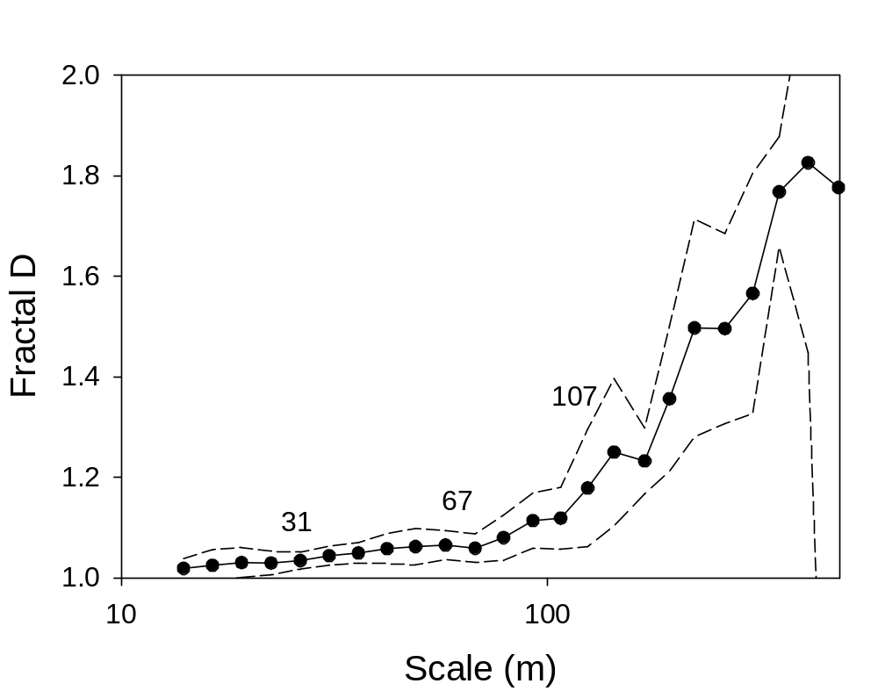
Fractal analysis of blacktip shark movement response to environment at different scales
Measure of tortuosity,
(1= line, 2 = path completely covers plane)
Sharks move with a directed walk at scales of 10-67 m
Move randomly between patches at scales > 107 m
Scale dependent
Fractal D
Scale independent
Papastamatiou et al, 2009 Ecology
Notes:
Solid line is mean VFractal. Dashed lines are 95 % confidence intervals

Slide 13
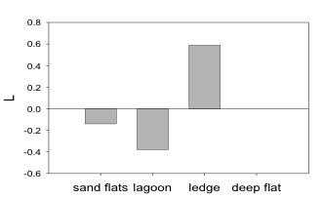
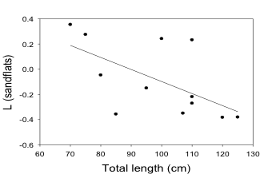
Habitat Selection
Strong selection for ledges
Avoid deeper lagoon waters
Ontogenetic shift in habitat selection
Small sharks show greater selection for sand-flats
L
L (flats)
L (habitat selection) = r1 - pi,
r1 = % use habitat i,
pi = % availability of habitat i
Notes:
FIG. I1. Habitat selection by blacktip reef sharks at Palmyra atoll.; (a) Habitat selection for all sharks combined (n = 13). L > 0 suggests selection for a habitat, while L < 0 suggests avoidance of a habitat. Observed use of habitat differed significantly from expected (P = 0.01). (b) Relationship between shark total length and selection coefficient for sand-flat habitats (y = -0.008x + 0.75, r² = 0.34, P = 0.04).
L >0 is selection, L<0 is avoidance

Slide 14
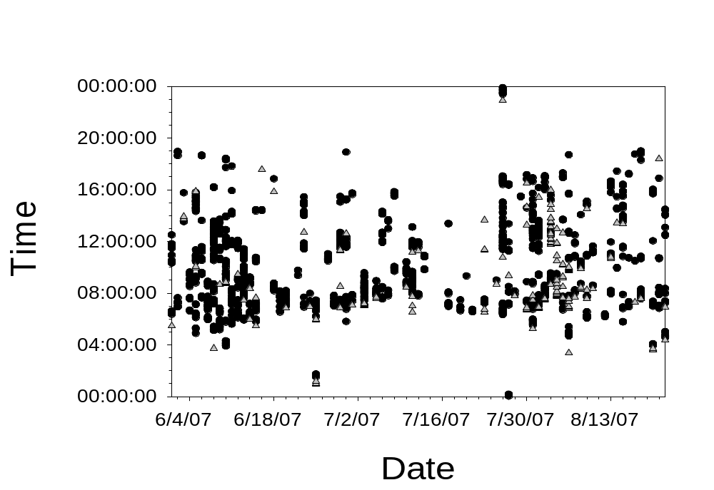
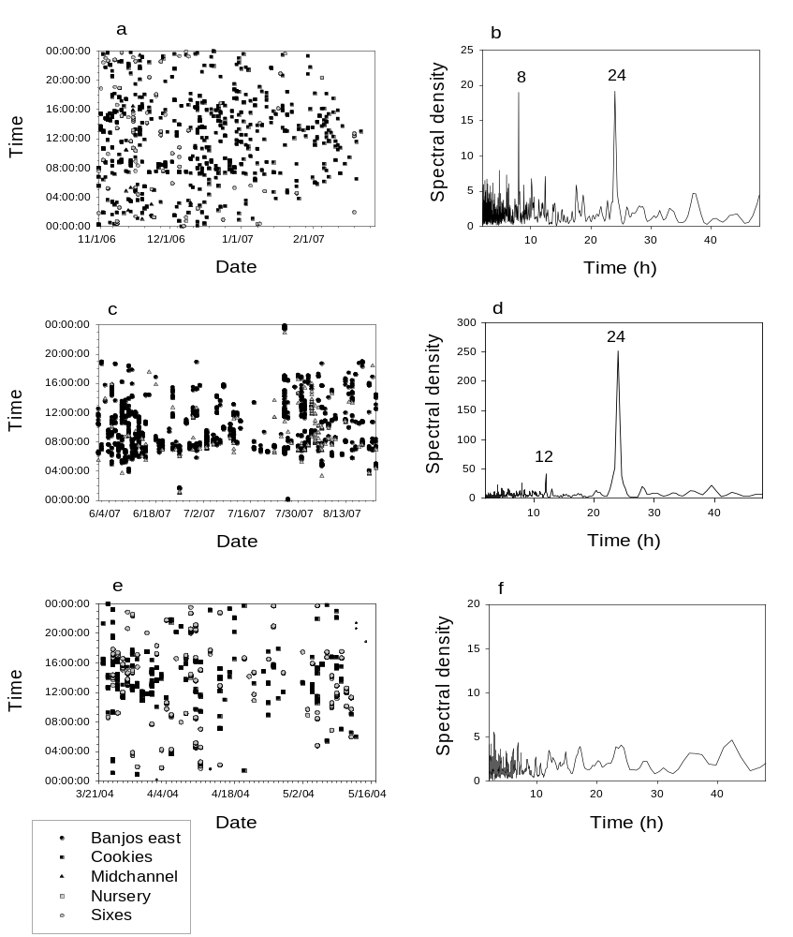
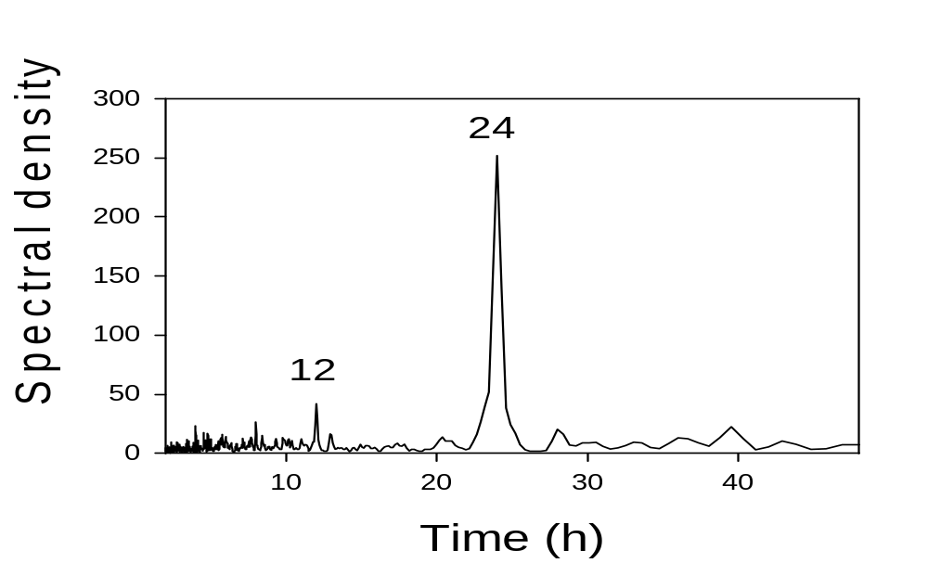
Diel and Tidal Behavior
Shark shows diel, and tidal cyclicity in detections
69 % of sharks showed diel peaks
52 % of sharks showed tidal peaks
FFT spectral analysis
Notes:
Weak tidal patterns , low spectral density

Slide 15
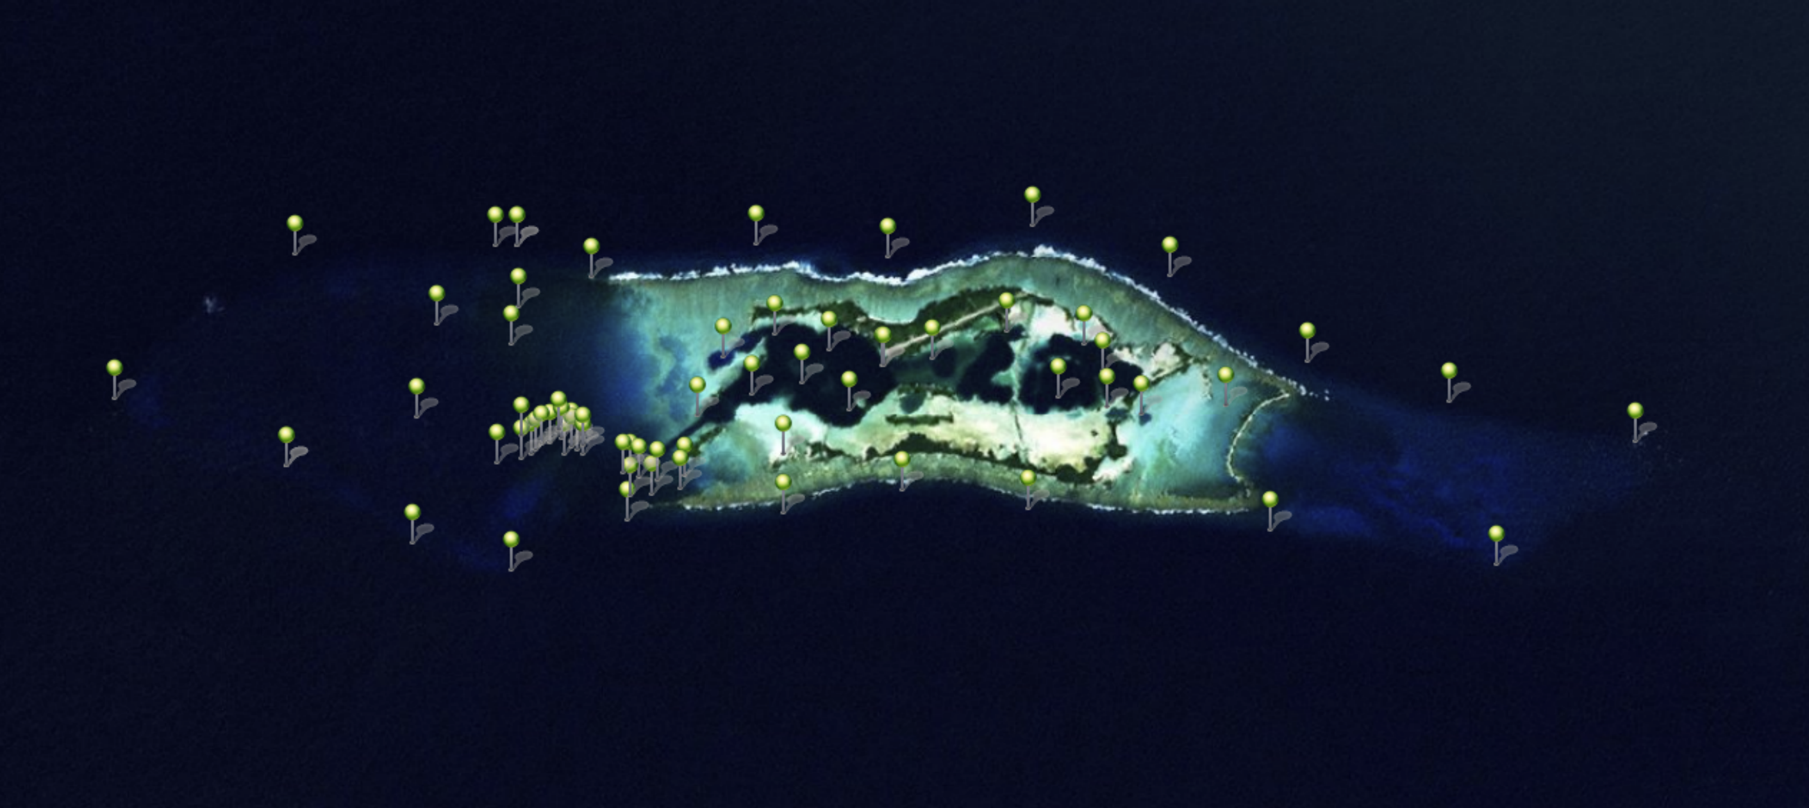
Current receiver array
63 VR2W acoustic receivers
All habitats monitored
Partnership between UH, USGS, AMNH, UCSB
Notes:
Want to show you just a few examples of some of the movement patterns we are seeing,..these are really anecdotes at this point, the goal is to put this all together into multispecies models

Slide 16
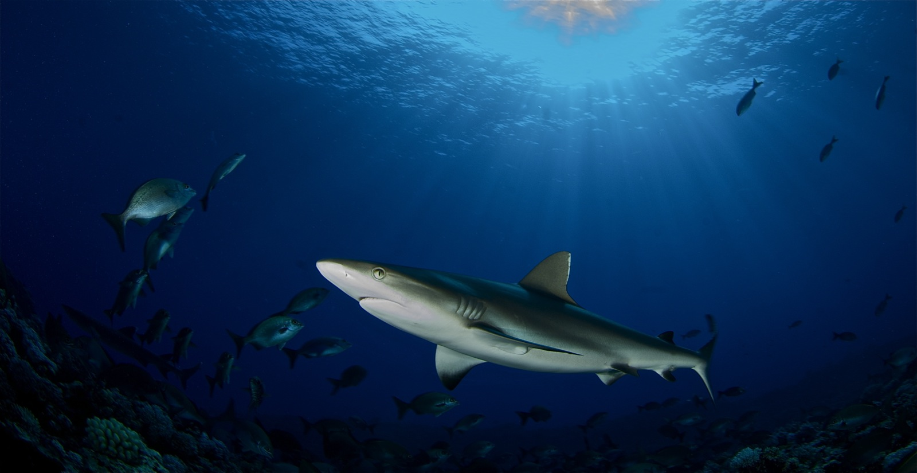
Grey Reef Shark – Carcharhinus amblyrhynchos
Individual variance is large
Moderate movement range
Vertical migration

Slide 17
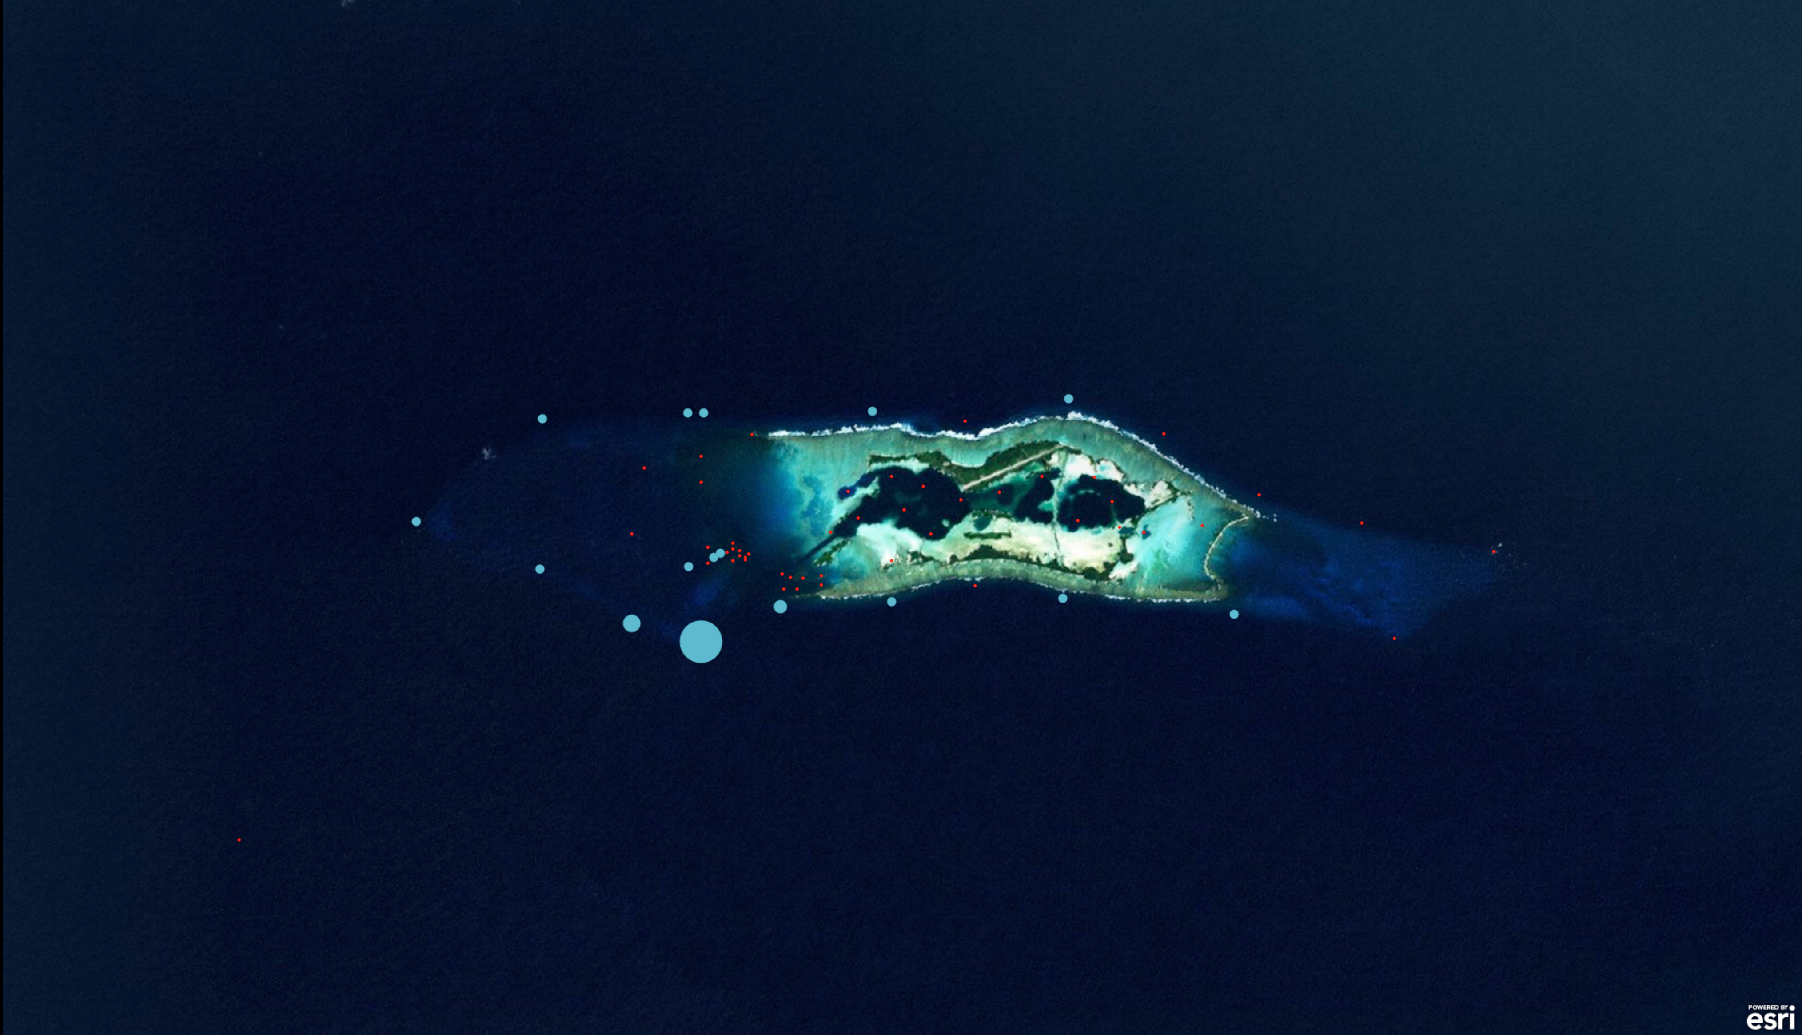
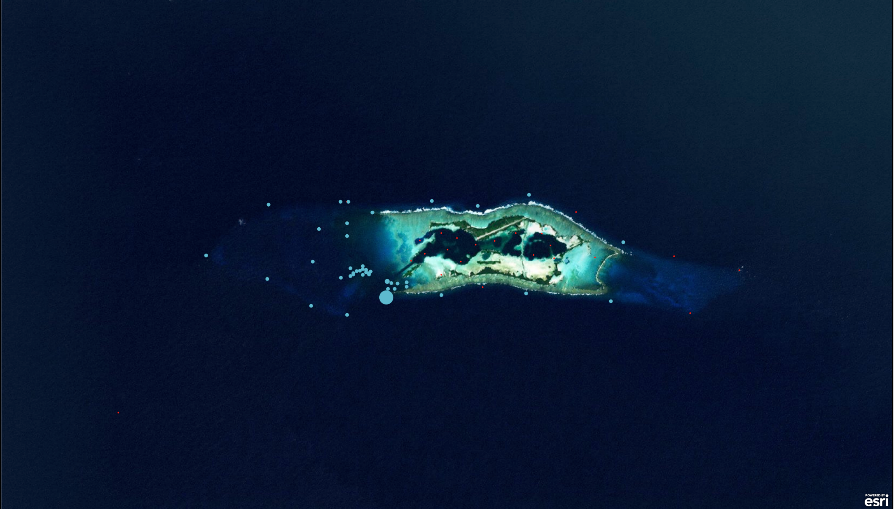
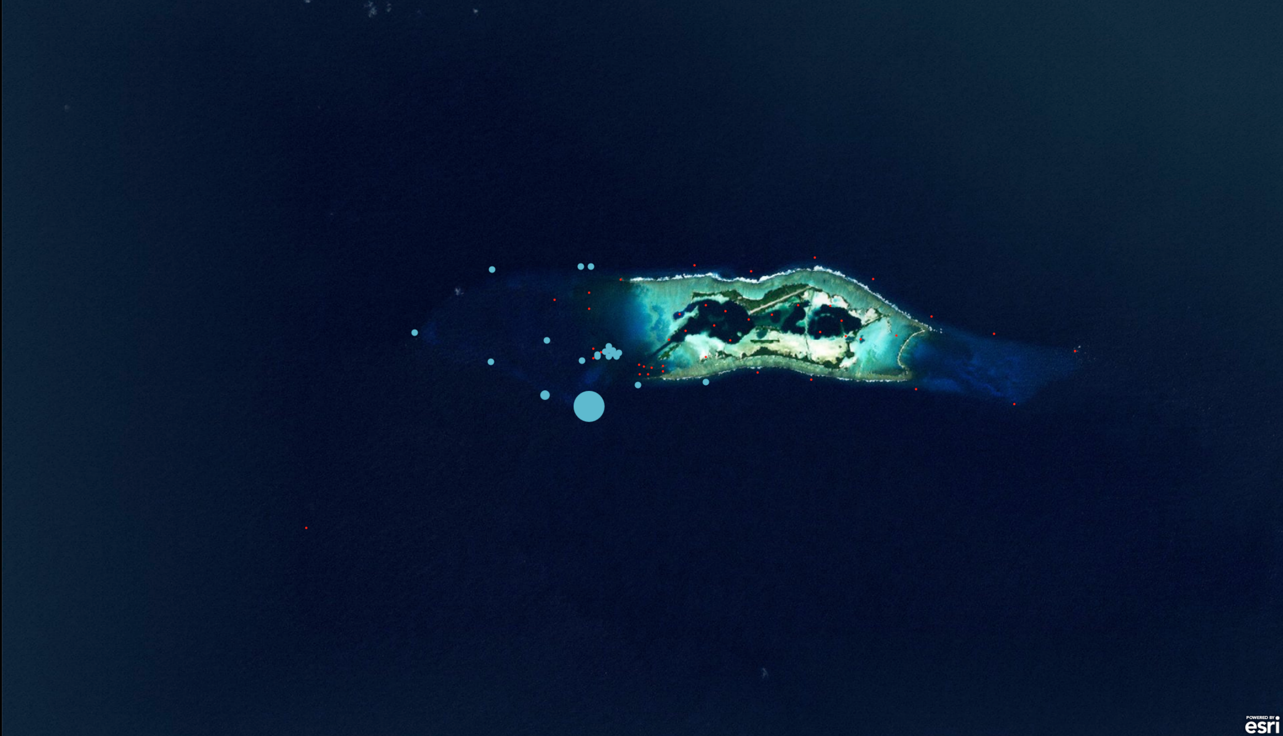
Tagging loc.
Primarily Forereef
3236 detections, 428 days, TL=162
Forereef, backreef & terrace
11421 detections, 640 days. TL=147
Western forereef & terrace
Hammerhead
Palmyra I
19540 detections, 642 days, TL=128

Slide 18
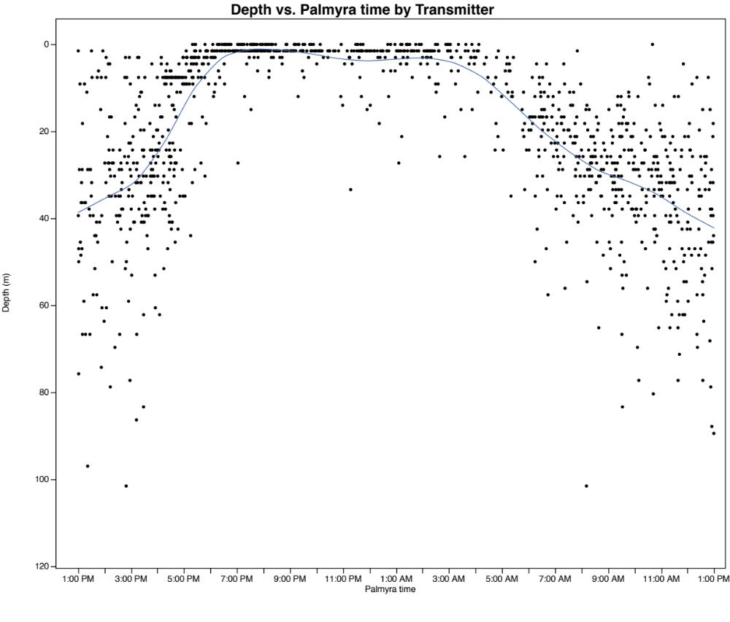
Grey reef sharks vertically migrate
0
20
40
Depth (m)
60
80
100
night
Time of Day
Notes:
Ramifications digestive physiol, for overlap with compettors and prey, for estiamtes of biomass using visiual surveys

Slide 19
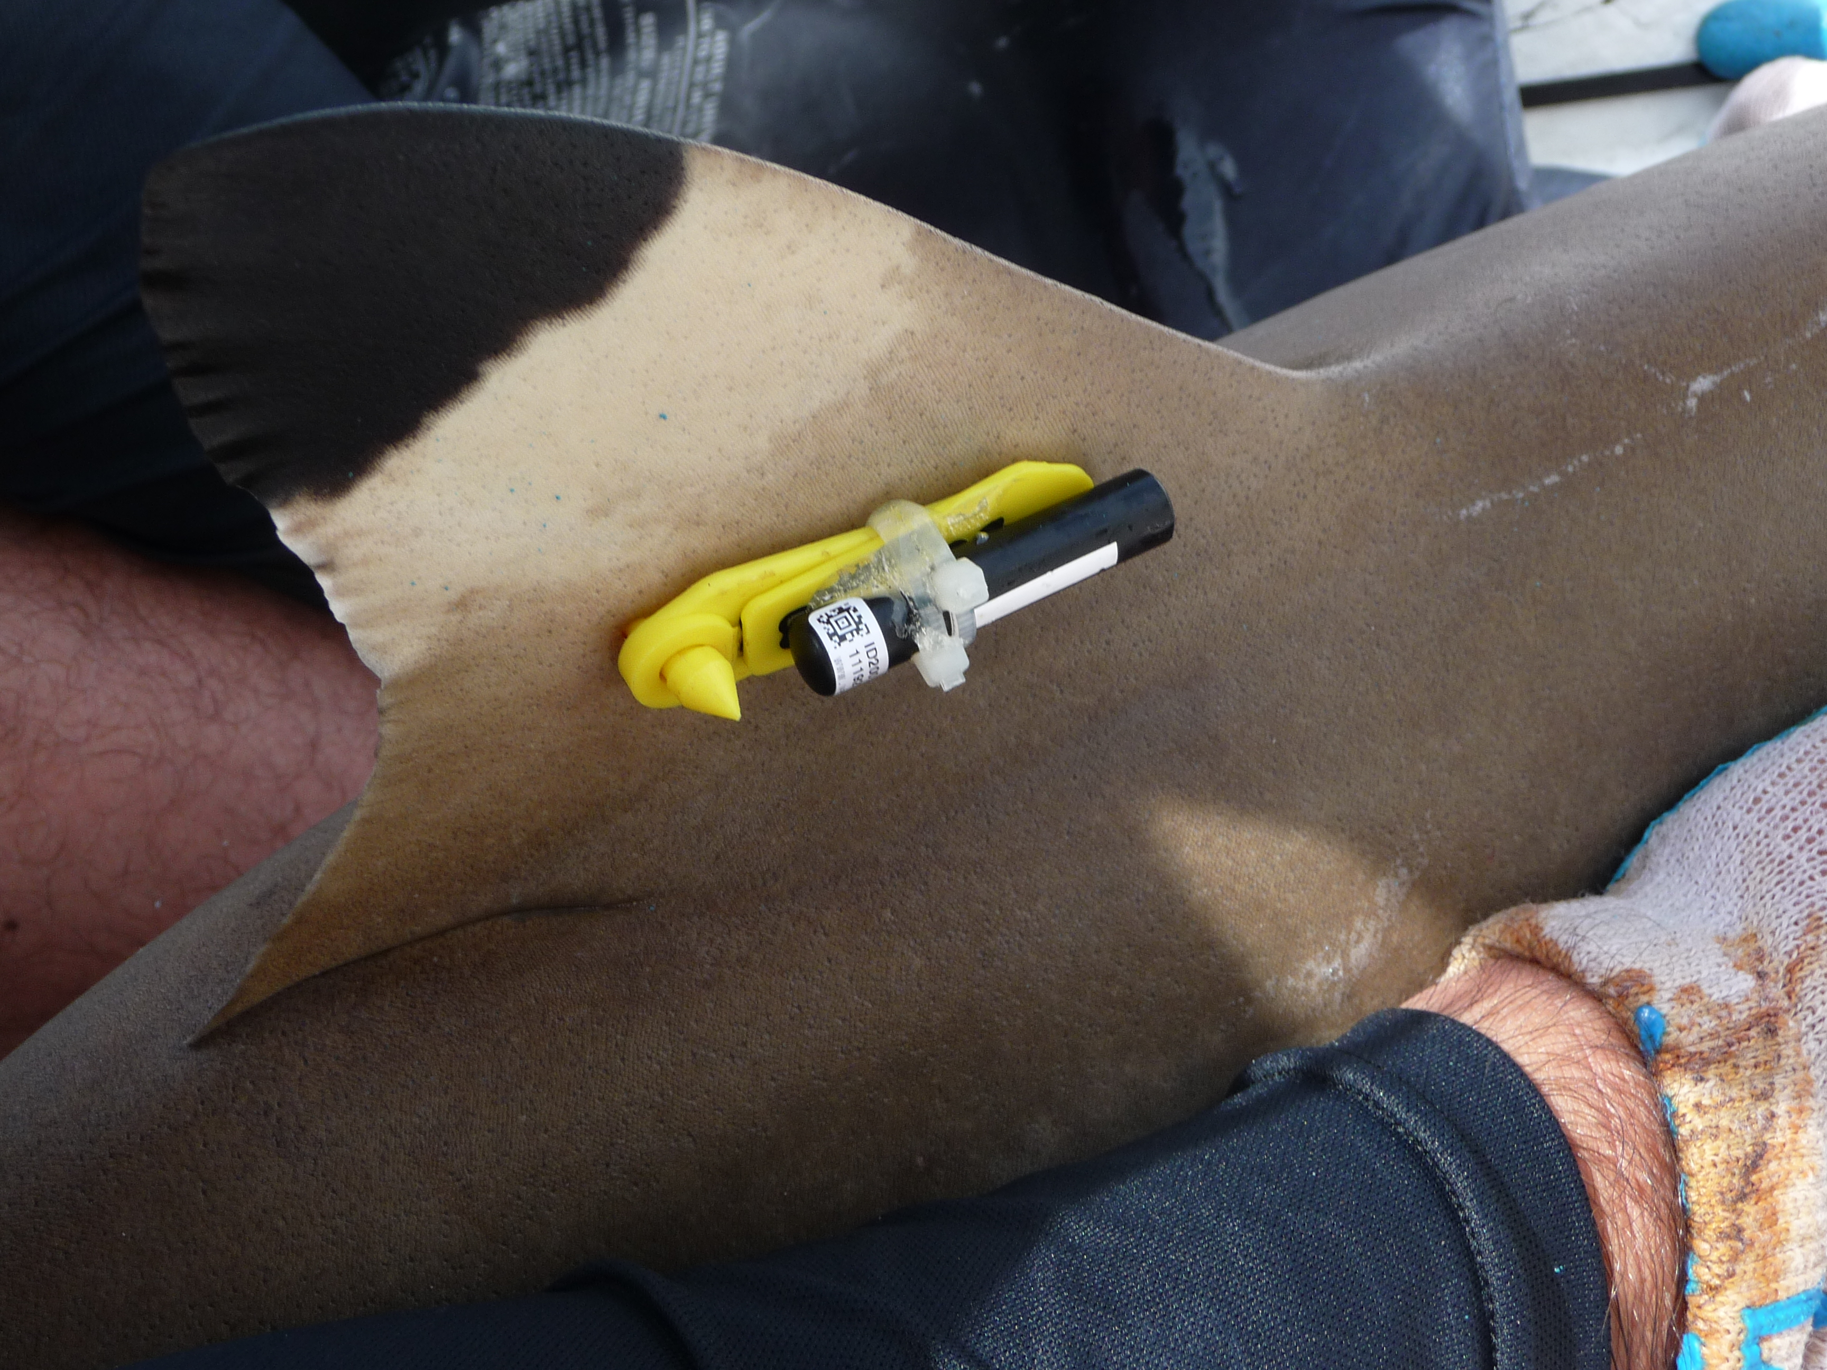
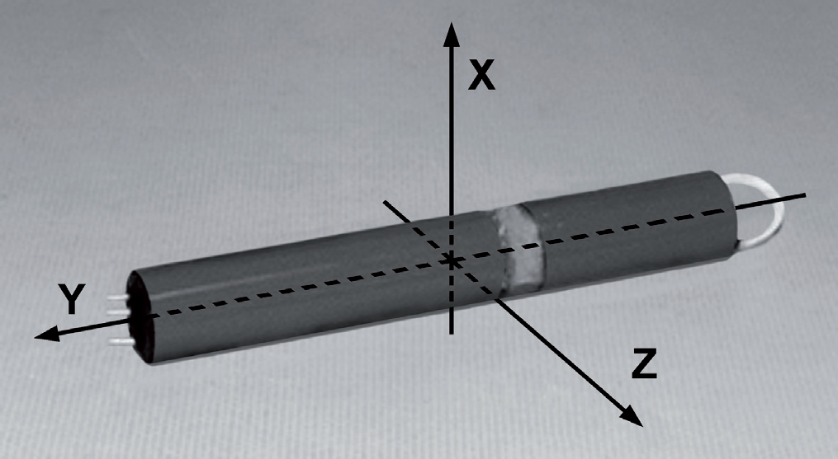
Acoustic transmitter with accelerometer and pressure sensor
Deployed in two blacktip reef sharks in Aug. 2011
Very preliminary results from a partial download of receivers

Slide 20
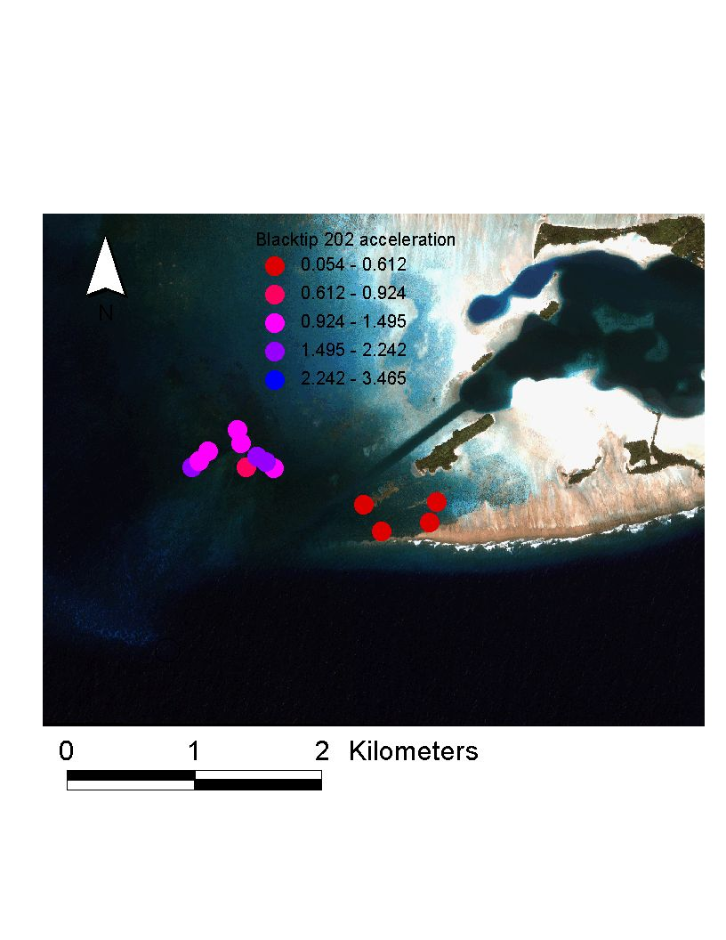
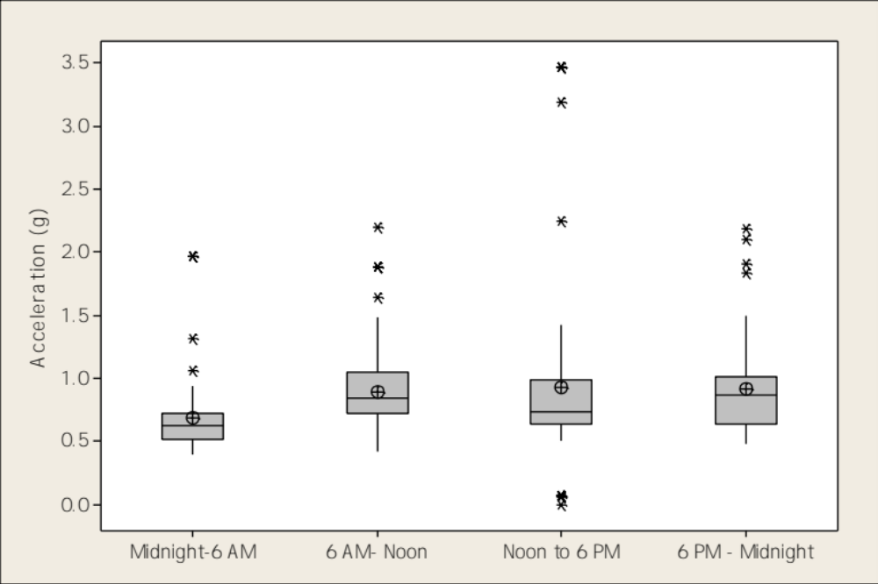
(m/s²)

Slide 21
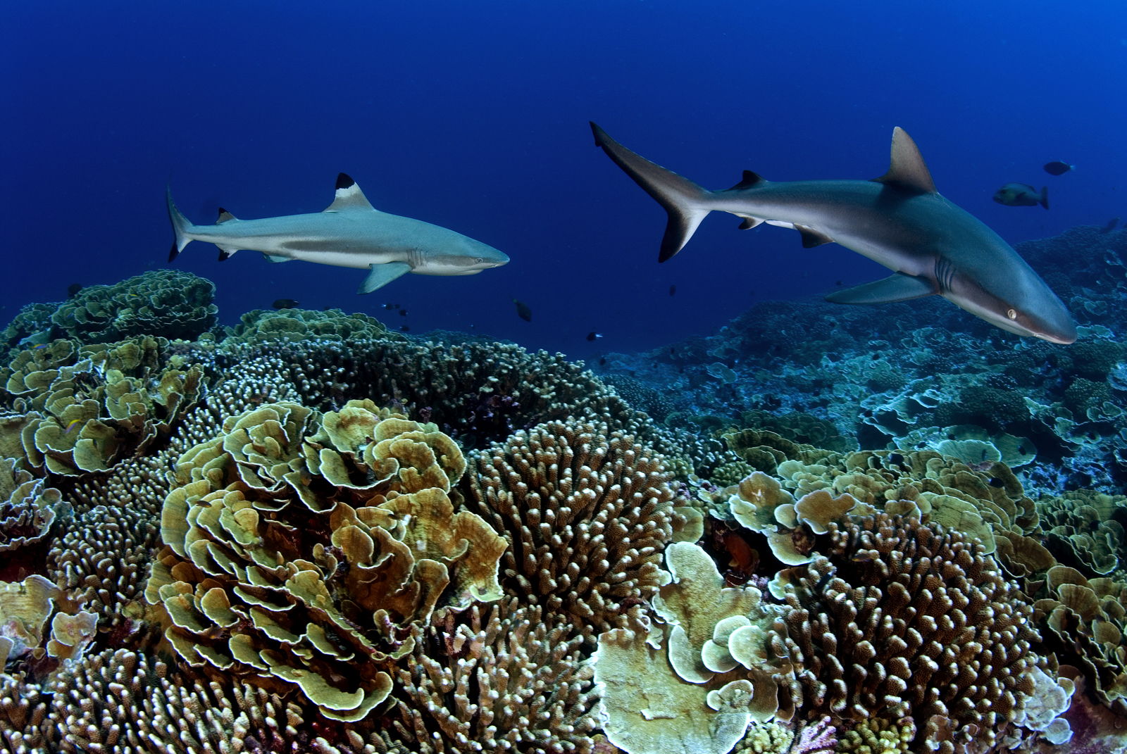
What can we learn from predator-dominated ecosystems?
Typically areas where anthropogenic influences kept to a minimum
MPAs may become predator-dominated
Yet, little known of ecological role of predators in these locations

Slide 22
Conservation of top predators will require:
an understanding of movement patterns and habitat utilization
development of mechanistic home range models
but also requires an understanding of the nature of behaviors:
  Why animals behave the way they do…
  How animals interact with each other…
Notes:
Mechanistic models of home range ot be able to predict home ranges in particular locations

Slide 23
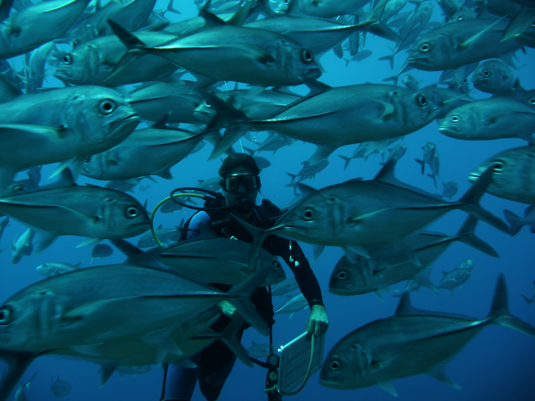
Support:
Marisla Foundation
The Nature Conservancy
Packard Foundation
US Fish & Wildlife Service
National Geographic

Slide 24
Notes:
At this point, we went back to bonefish and killed a dozen more or so until we realized that there were a lot more predators to tag…

Slide 25
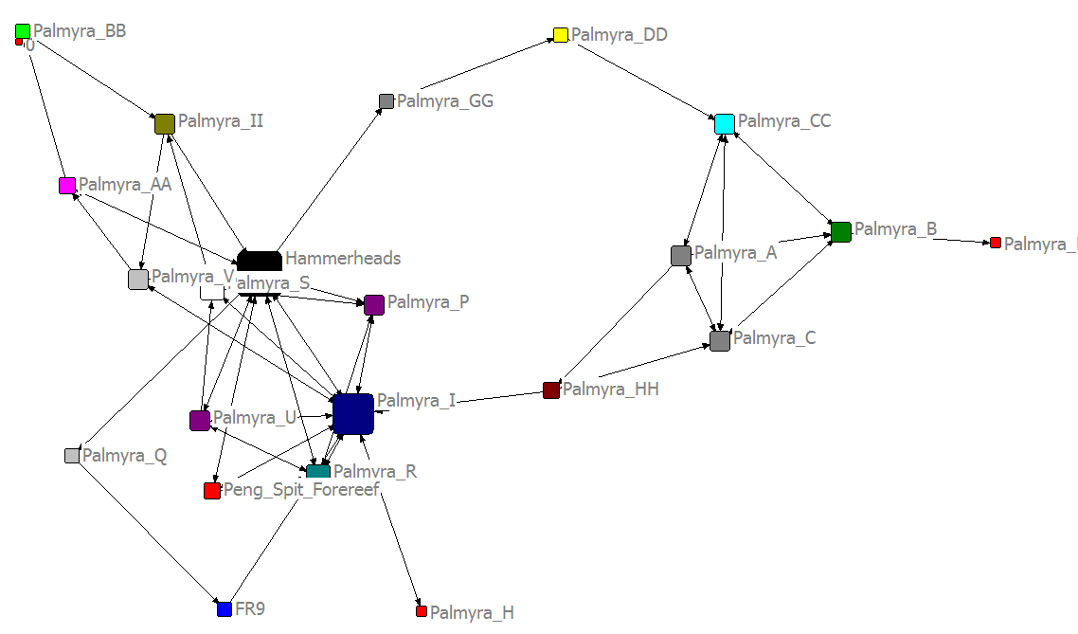
Network analysis of Grey Reef 61342
Highest centrality at two receivers closest to tagging location

Slide 26
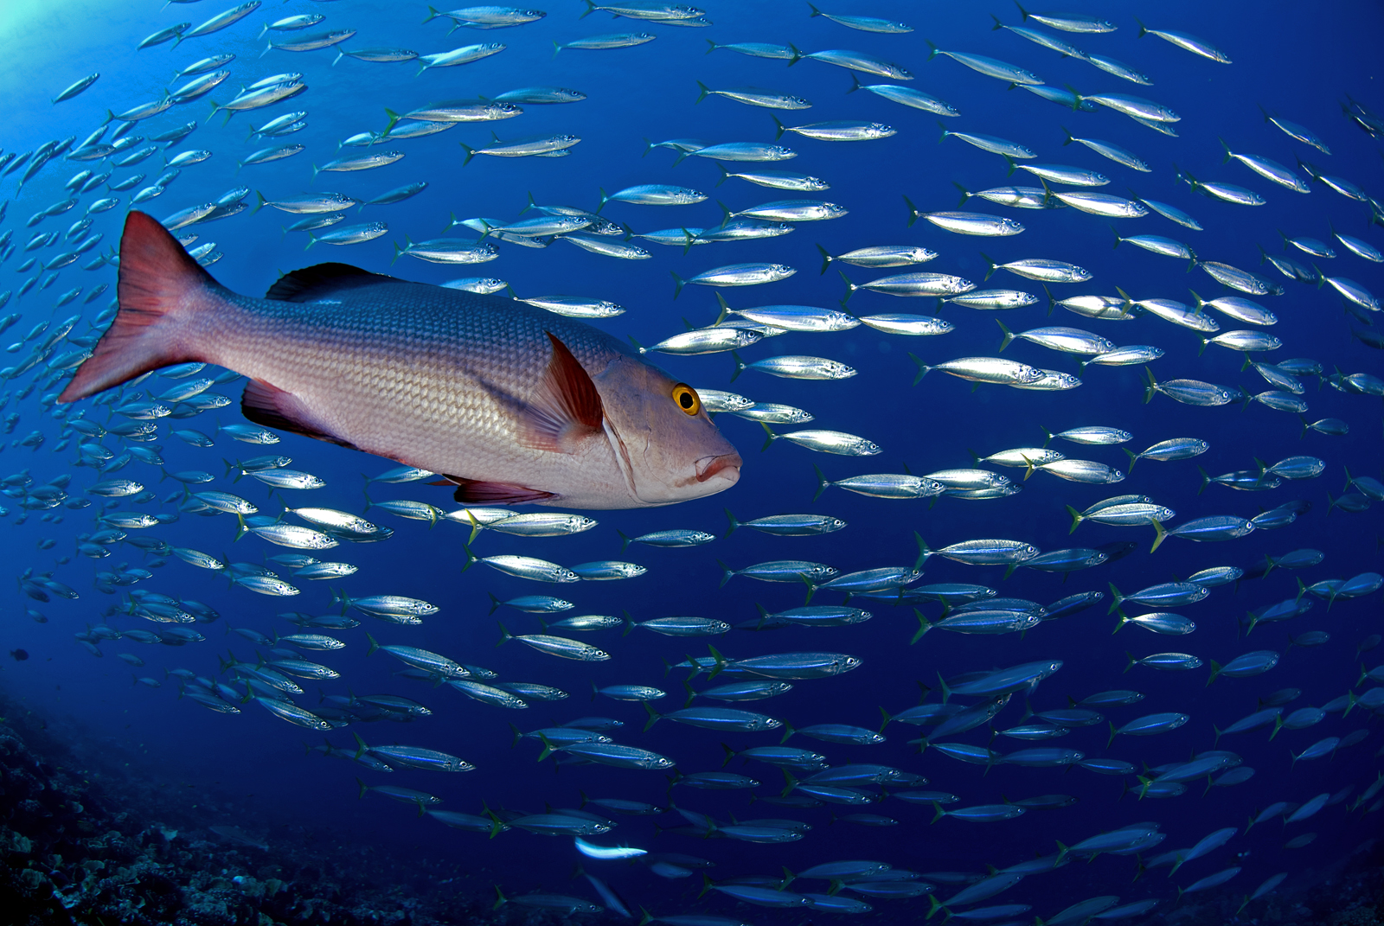
Bohar snapper (Lutjanus bohar)
Very strong site fidelity
Diel patterns in detections

Slide 27
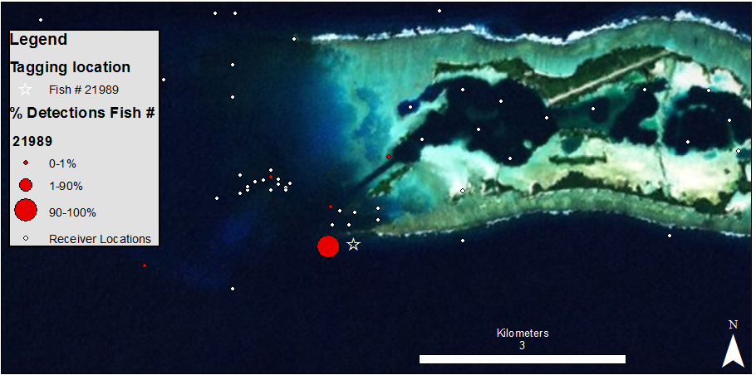
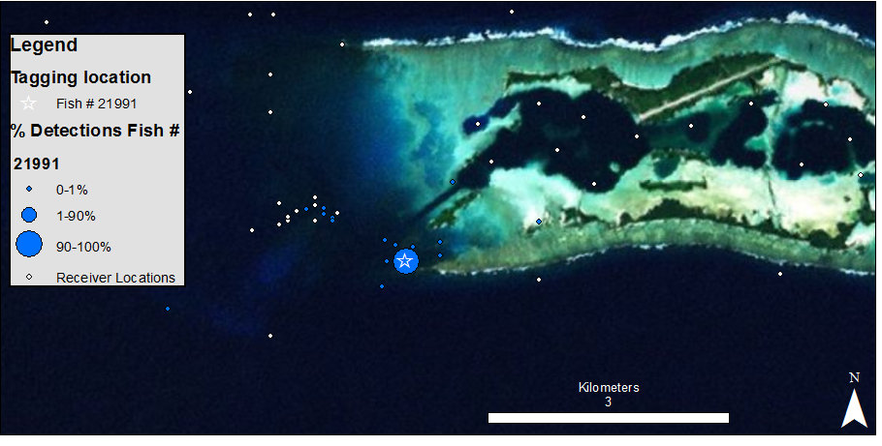

- Half of all tagged fish (n=20) had >90% of detections on single receiver
- Strong diel patterns, virtually no detections at night

Slide 28
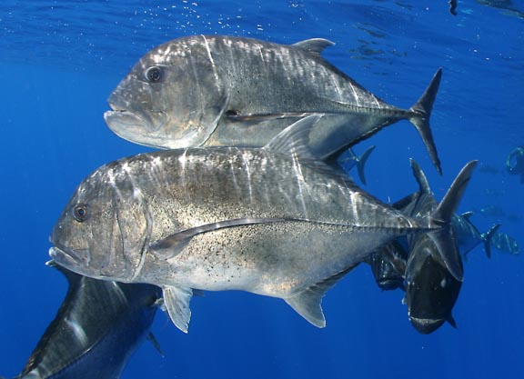
Giant trevally (Caranx ignobilis)
Strong diel patterns
Possible ontogenetic movement

Slide 29
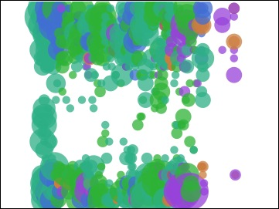
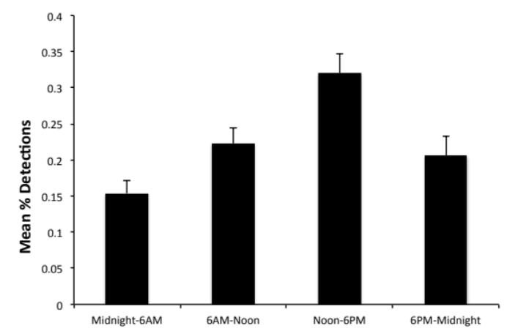

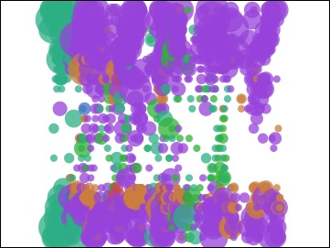
Day
Time (gmt)
Night
Day
Few detections at night
Time (gmt)
Main Channel
No. Forereef
Peng Spit BR
Rubble pile
So. Forereef
West. terrace
Notes:
Meyer et al found that ulua use different areas at day and nighttime. Detections during day maybe b/c we fish durin gthe day and caught them in their daytime use areas…..

Slide 30
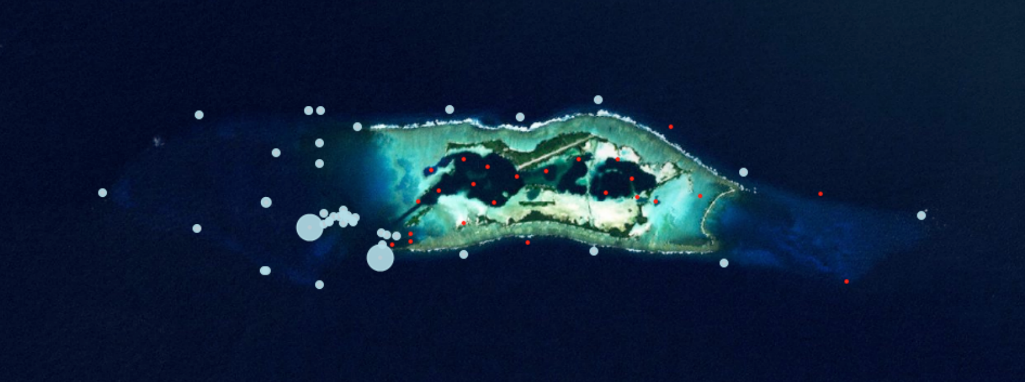
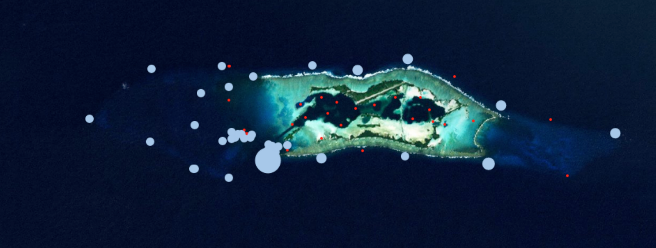
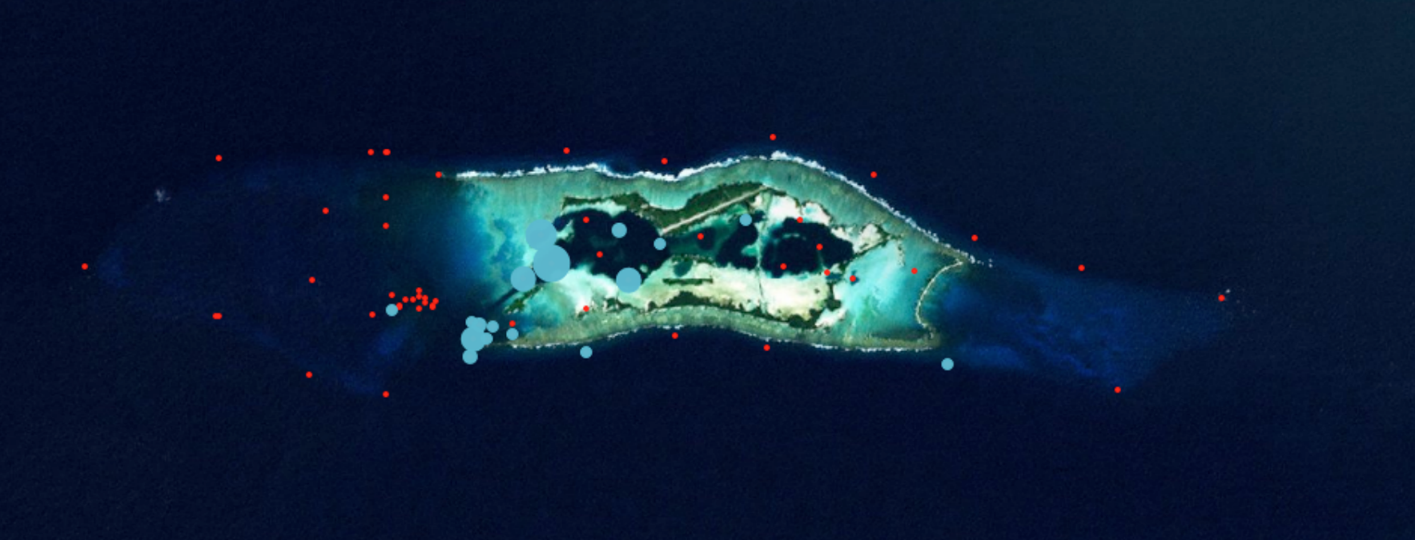

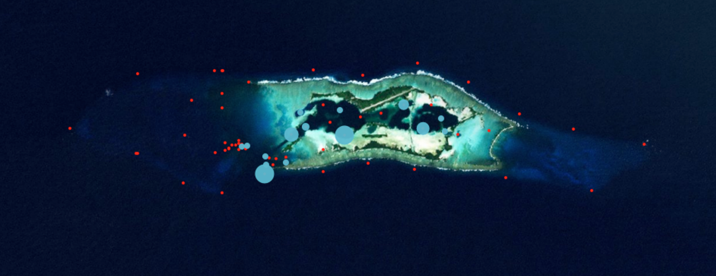
Giant trevally tagged on the forereef and terrace are larger and do not use lagoon
Tagging loc
Giant trevally tagged in the lagoon are smaller and do not venture far out on the forereef/terraces
43868, FL=85
43872, FL=88
63103, FL=70
43877, FL=100
63096, FL=57
Avg. FL on Forereef = 86.2 cm
Avg. FL in Lagoon = 67.8 cm

